Slide 1
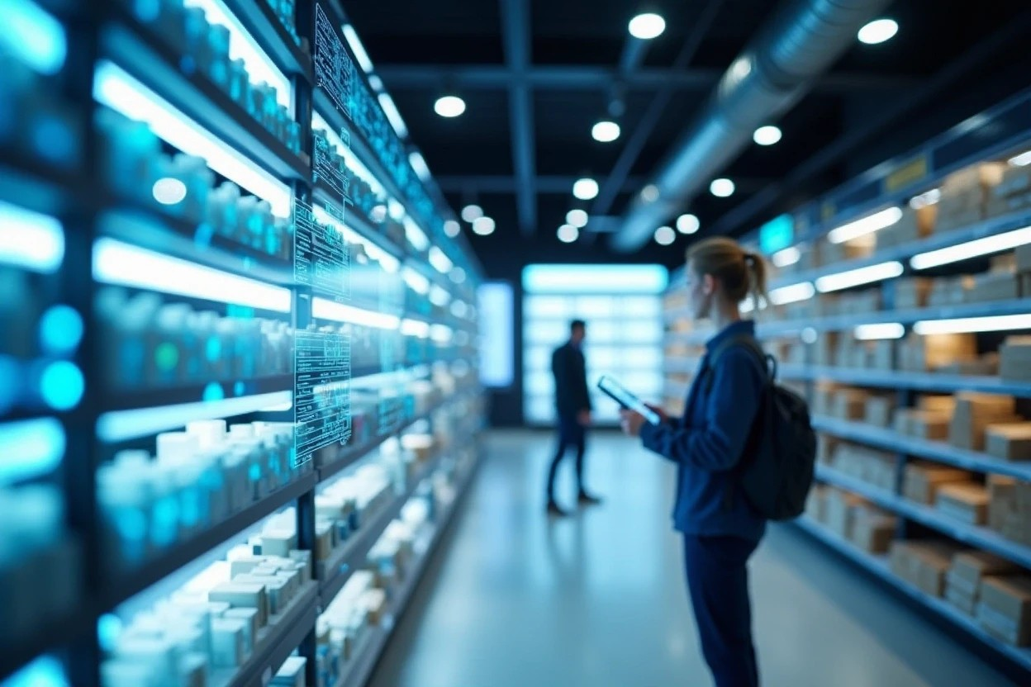
RetailIQ - Smart Retail Operations & Analytics Platform
Sr. | Enrollment | Name
1 | 21004500210065 | Arnold Macwan
2 | 21004500210094 | Manthan Parmar

Slide 2
Introduction
The retail sector is undergoing in a massive digital transformation driven by the increasing need for efficiency, intelligent decision making and data-driven operations. Meanwhile the large organization leverage sophisticated use of AI-powered tools and automation techniques, but the small-medium size enterprises often rely manual processes and operations and traditional POS – point of sale systems.
RetailIQ is designed to bridge this technological gap by providing a smart and unified platform which combines all the management and processes with advanced analytics. The system empowers local shops, supermarkets, and fashion stores to manage inventory, track sales, monitor supplier performance, and understand purchase patterns — all in a centralized ecosystem.

Slide 3

Existing System
In the current retail environment, most small and medium-sized stores rely on traditional Point-of-Sale (POS) software or manual methods to manage their operations. These existing systems primarily focus on basic functionalities such as billing, inventory updates, and transaction recording. While effective for routine tasks, they lack intelligent decision-support capabilities. Retailers must manually analyse sales data, estimate future demand, and track stock levels, which often leads to inaccuracies and inefficiencies.
Overall, the existing system is transactional rather than analytical. It records data but does not help retailers interpret it for strategic decisions. As a result, retail operations become reactive, inefficient, and less competitive in the modern digital market.

Slide 4
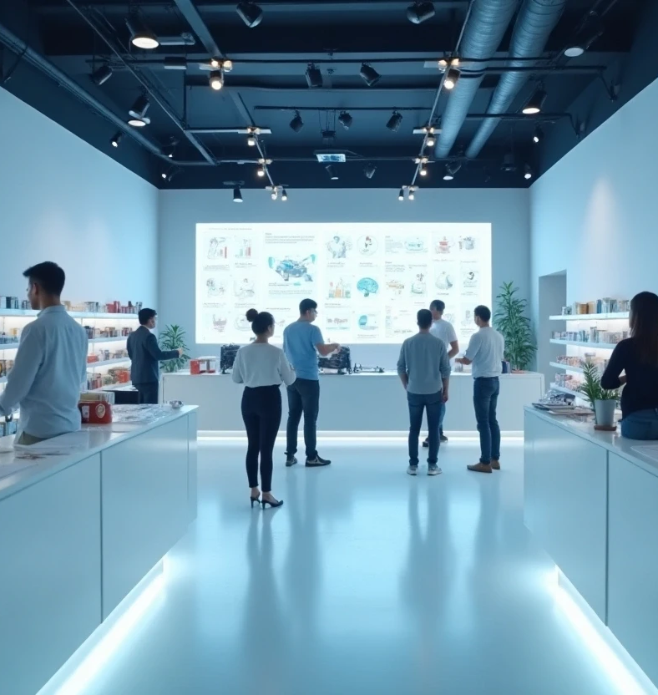
Need for new system
Enhance decision making
Prevent stock-out
Understand customer behavior
Streamline business management
Reduce human error

Slide 5
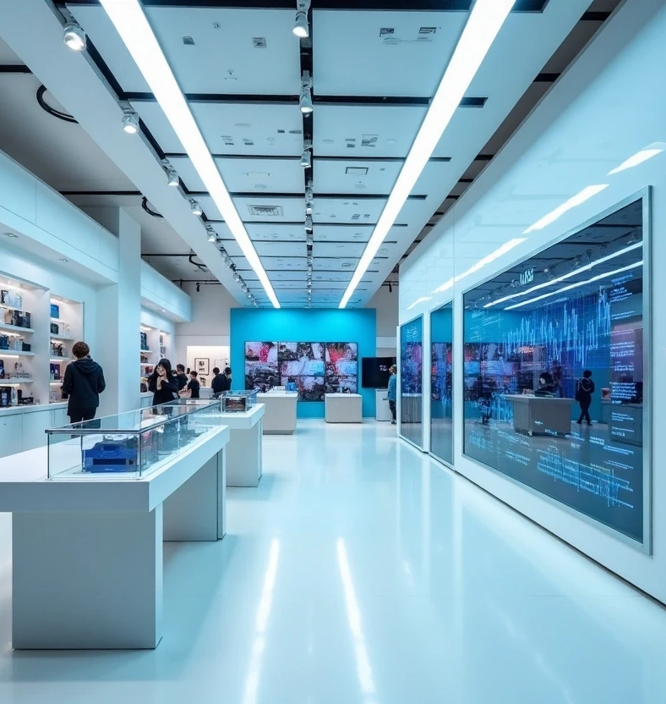
Objective
Automate & optimize inventory management
Advanced sales & profit analysis
Data-driven decision making
Enhance customer relations
Improve accuracy
Scalable and unified platform

Slide 6
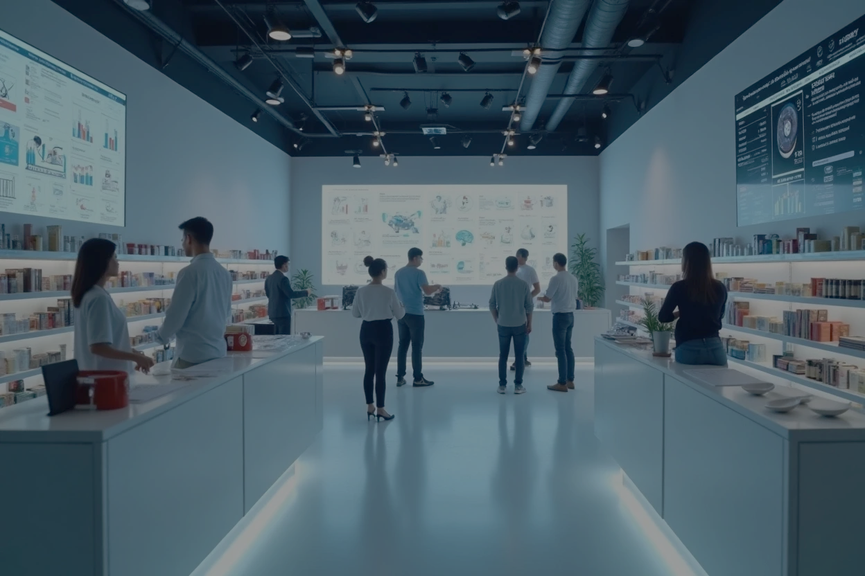
Problem statement
Retail businesses, especially small and mid-sized stores, generate large volumes of transactional data through daily sales, purchases, and inventory movements. However, most retailers lack the tools and expertise to analyze this data effectively. These limitations prevent retailers from operating efficiently, understanding their customers, or forecasting future business needs. Therefore, the problem is the absence of a unified, smart retail management system that not only handles operations but also provides predictive analytics, actionable insights, and intelligent decision support for modern retail environments.

Slide 7
Scope of the project
Analytical scope
Operational scope
Demand forecasting
Market basket analysis
Stock prediction
Interactive dashboards
Inventory management
Sales & Billing integration
Supplier & purchase management

Slide 8
Scope of the project
Technical scope
Out of scope
The system is intended for
Frontend interface
Backend services
API services
Database systems
Machine learning pipelines
Multi-store management
Real-time or barcode hardware systems
Integration with third part e-commerce systems
Local shop owners
Vendors, mini-markets
Retails stores

Slide 9
Project profile
Project Name | RetailIQ
Frontend | HTML, CSS, JavaScript, ReactJS
Backend | ExpressJS, NodeJS
Database | MongoDB, MySQL
ML Services | Python, FastAPI
Tools | VS Code, MS-Office

Slide 10
Core components
Admin | Supplier | Customer | Store manager
Login Manage suppliers Manage stores Manage permissions Analytics & monitoring Pricing & Discounts Reports Logout | Login Manage purchases Products & pricing Communication Profile management Order analytics Logout | Login Registration Profile management Past purchases Feedbacks Orders & Wishlist Logout | Login Profile Management Inventory management Sales & Billing Manage supplies Sales dashboard Store level Analytics Logout

Slide 11

Assumptions & Constraints
Datasets uploaded will be safe and non-corrupted.
Users will provide timely iteration feedback.
System requires stable internet for external APIs.
Users will have basic digital skills to use the dashboard.
Retailers will supply accurate sales, inventory, and purchase data.
Additional historical data will be used when retailer data is insufficient.

Slide 12

Constraints
Limited system resources may restrict large ML training.
Low-tech retailers may need usage training.
Limited historical data reduces forecasting accuracy.
Server capacity affects performance on large datasets.
Browser limits may restrict advanced visuals.
ML accuracy varies with data size, seasonality, and store type.

Slide 13
Advantages & Limitations
Advantages
Limitation
Data-driven decision making
Improved inventory management
Enhanced profitability
Better customer segmentation and understanding
Enhanced stock management
Accuracy depends on data quality
Can’t capture external market factors for model training
Limited real-time analytics
Lack of back-up service
Multilingual support
Low maintenance

Slide 14
Requirement determination
Requirement determination and gathering has been done through several methods and techniques such as:
Interviews
Observations of existing system
Case studies
Surveys/Feedbacks
Industry research

Slide 15
Requirement analysis
Non-functional requirement
Functional requirement
Performance requirement
Reliability
Usability
Security
Scalability
User requirement
Inventory management
Sales management
Supplier management
AI-ML module
Dashboard & Reporting
User management
Easy product/inventory management
Sales analytics
Recommendation
Reports
Accessible

Slide 16
Targeted Users
Store Manager
Admin
Customer
Supplier

Slide 17
THANK YOU…!!

